Slide 1


Slide 2
Your Logo
stamp
Celebrate Ruby Bridges Day!
On November 14, 1960, Ruby Bridges made history by becoming the first African American student to attend an all-white elementary school in the South. Her courage at just six years old helped pave the way for racial integration in schools.
Join us in honoring Ruby's bravery by participating in [Your School's Event] on [Date]. Walk to school, wear white, or discuss Ruby’s story in class.
Together, we can continue her legacy of equality and justice.
Learn More and Get Involved:
<School Website/Contact Info>
Let's walk in unity and celebrate the power of courage!
______________________________________________
_______________________
_______________________
Your Logo
stamp
Celebrate Ruby Bridges Day!
On November 14, 1960, Ruby Bridges made history by becoming the first African American student to attend an all-white elementary school in the South. Her courage at just six years old helped pave the way for racial integration in schools.
Join us in honoring Ruby's bravery by participating in [Your School's Event] on [Date]. Walk to school, wear white, or discuss Ruby’s story in class.
Together, we can continue her legacy of equality and justice.
Learn More and Get Involved:
<School Website/Contact Info>
Let's walk in unity and celebrate the power of courage!
______________________________________________
_______________________
_______________________

Slide 3
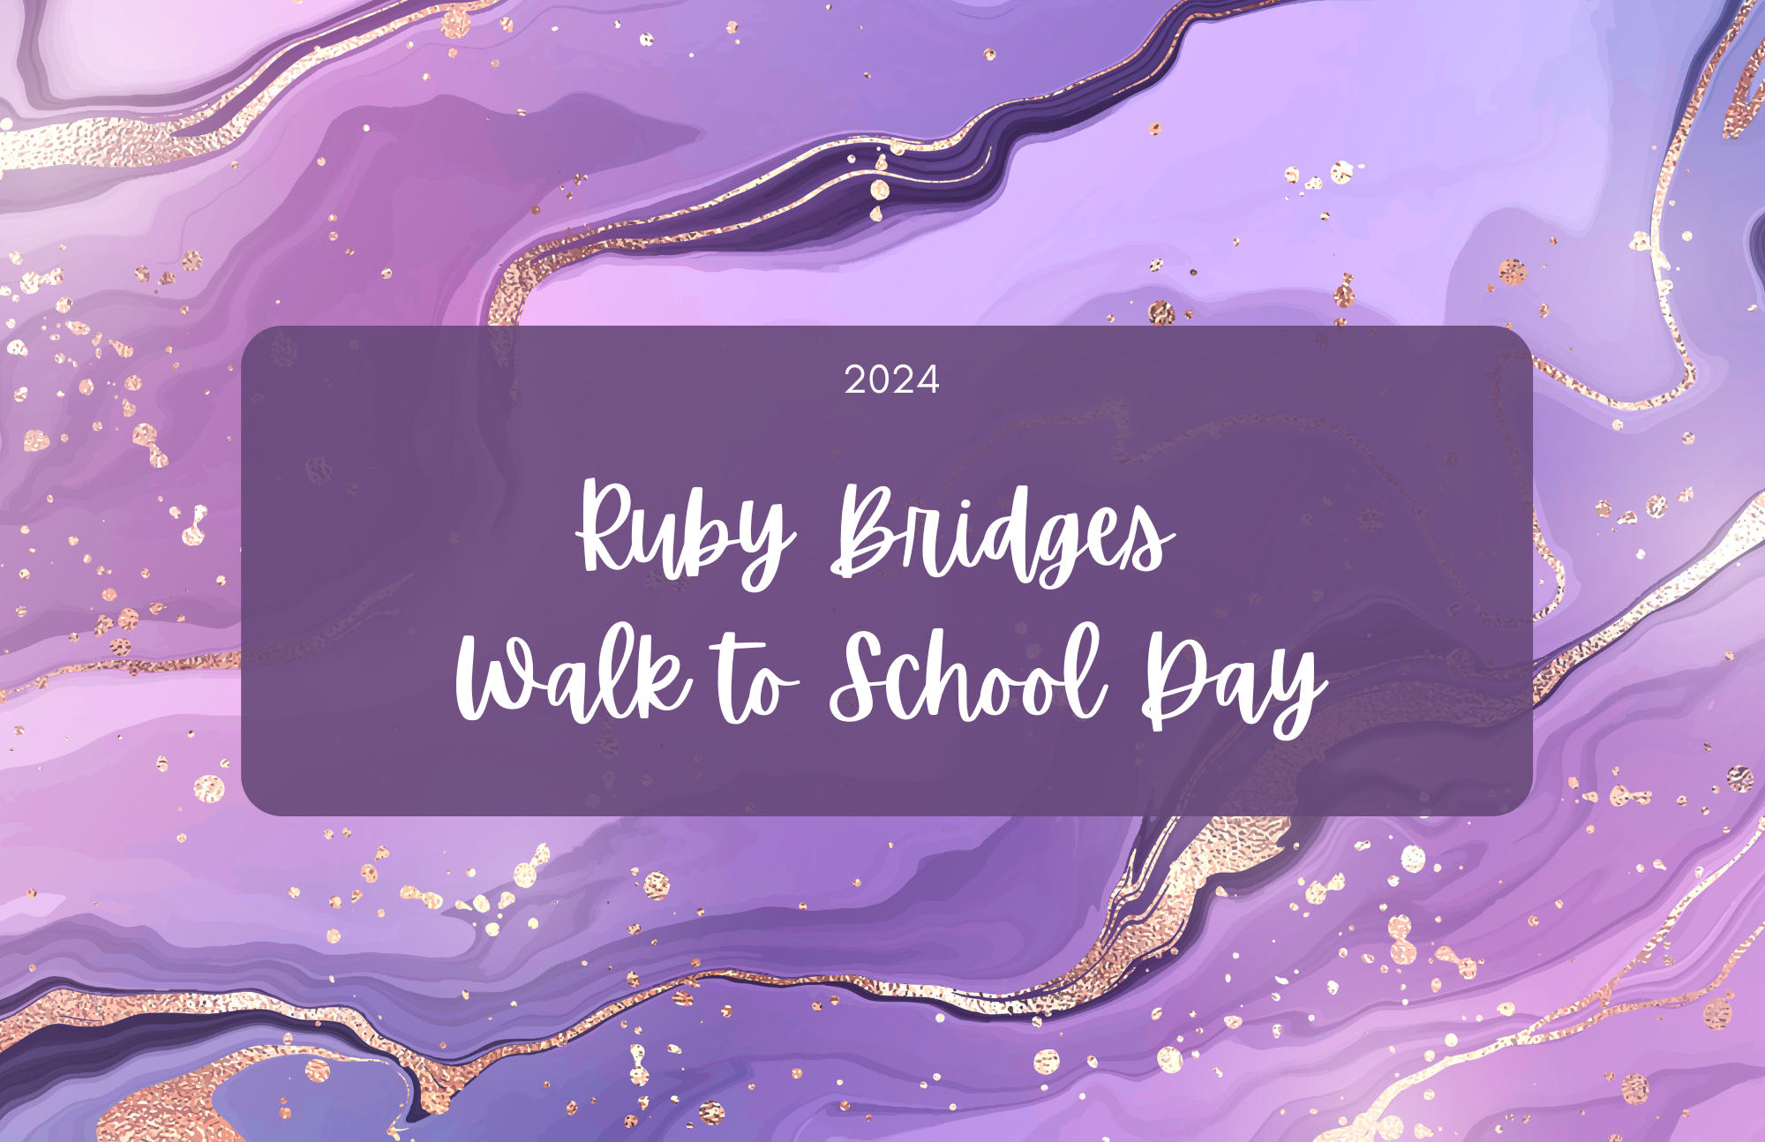

Slide 4
Your Logo
stamp
Celebrate Ruby Bridges Day!
On November 14, 1960, Ruby Bridges made history by becoming the first African American student to attend an all-white elementary school in the South. Her courage at just six years old helped pave the way for racial integration in schools.
Join us in honoring Ruby's bravery by participating in [Your School's Event] on [Date]. Walk to school, wear white, or discuss Ruby’s story in class.
Together, we can continue her legacy of equality and justice.
Learn More and Get Involved:
<School Website/Contact Info>
Let's walk in unity and celebrate the power of courage!
______________________________________________
_______________________
_______________________
Your Logo
stamp
Celebrate Ruby Bridges Day!
On November 14, 1960, Ruby Bridges made history by becoming the first African American student to attend an all-white elementary school in the South. Her courage at just six years old helped pave the way for racial integration in schools.
Join us in honoring Ruby's bravery by participating in [Your School's Event] on [Date]. Walk to school, wear white, or discuss Ruby’s story in class.
Together, we can continue her legacy of equality and justice.
Learn More and Get Involved:
<School Website/Contact Info>
Let's walk in unity and celebrate the power of courage!
______________________________________________
_______________________
_______________________

Slide 5
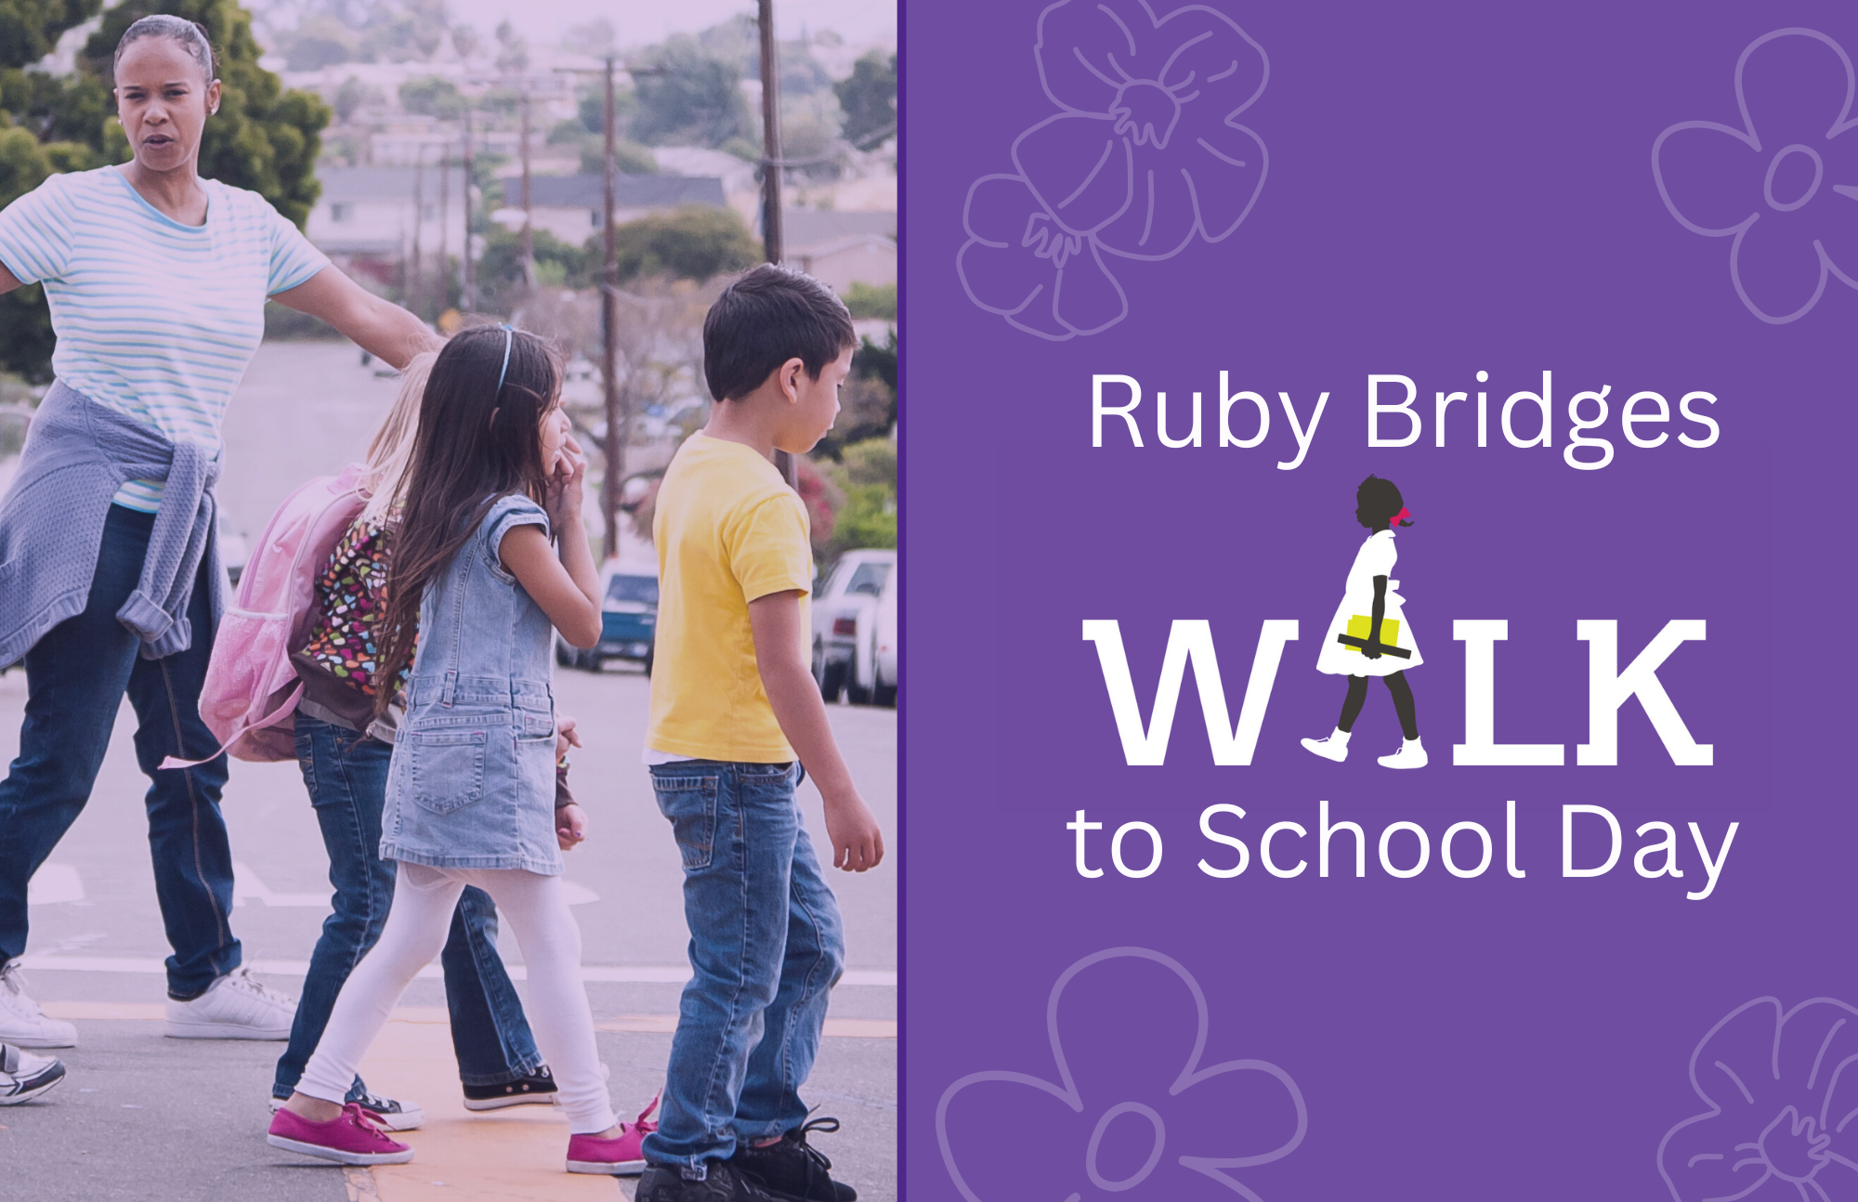

Slide 6
Your Logo
stamp
Celebrate Ruby Bridges Day!
On November 14, 1960, Ruby Bridges made history by becoming the first African American student to attend an all-white elementary school in the South. Her courage at just six years old helped pave the way for racial integration in schools.
Join us in honoring Ruby's bravery by participating in [Your School's Event] on [Date]. Walk to school, wear white, or discuss Ruby’s story in class.
Together, we can continue her legacy of equality and justice.
Learn More and Get Involved:
<School Website/Contact Info>
Let's walk in unity and celebrate the power of courage!
______________________________________________
_______________________
_______________________
Your Logo
stamp
Celebrate Ruby Bridges Day!
On November 14, 1960, Ruby Bridges made history by becoming the first African American student to attend an all-white elementary school in the South. Her courage at just six years old helped pave the way for racial integration in schools.
Join us in honoring Ruby's bravery by participating in [Your School's Event] on [Date]. Walk to school, wear white, or discuss Ruby’s story in class.
Together, we can continue her legacy of equality and justice.
Learn More and Get Involved:
<School Website/Contact Info>
Let's walk in unity and celebrate the power of courage!
______________________________________________
_______________________
_______________________

Slide 7
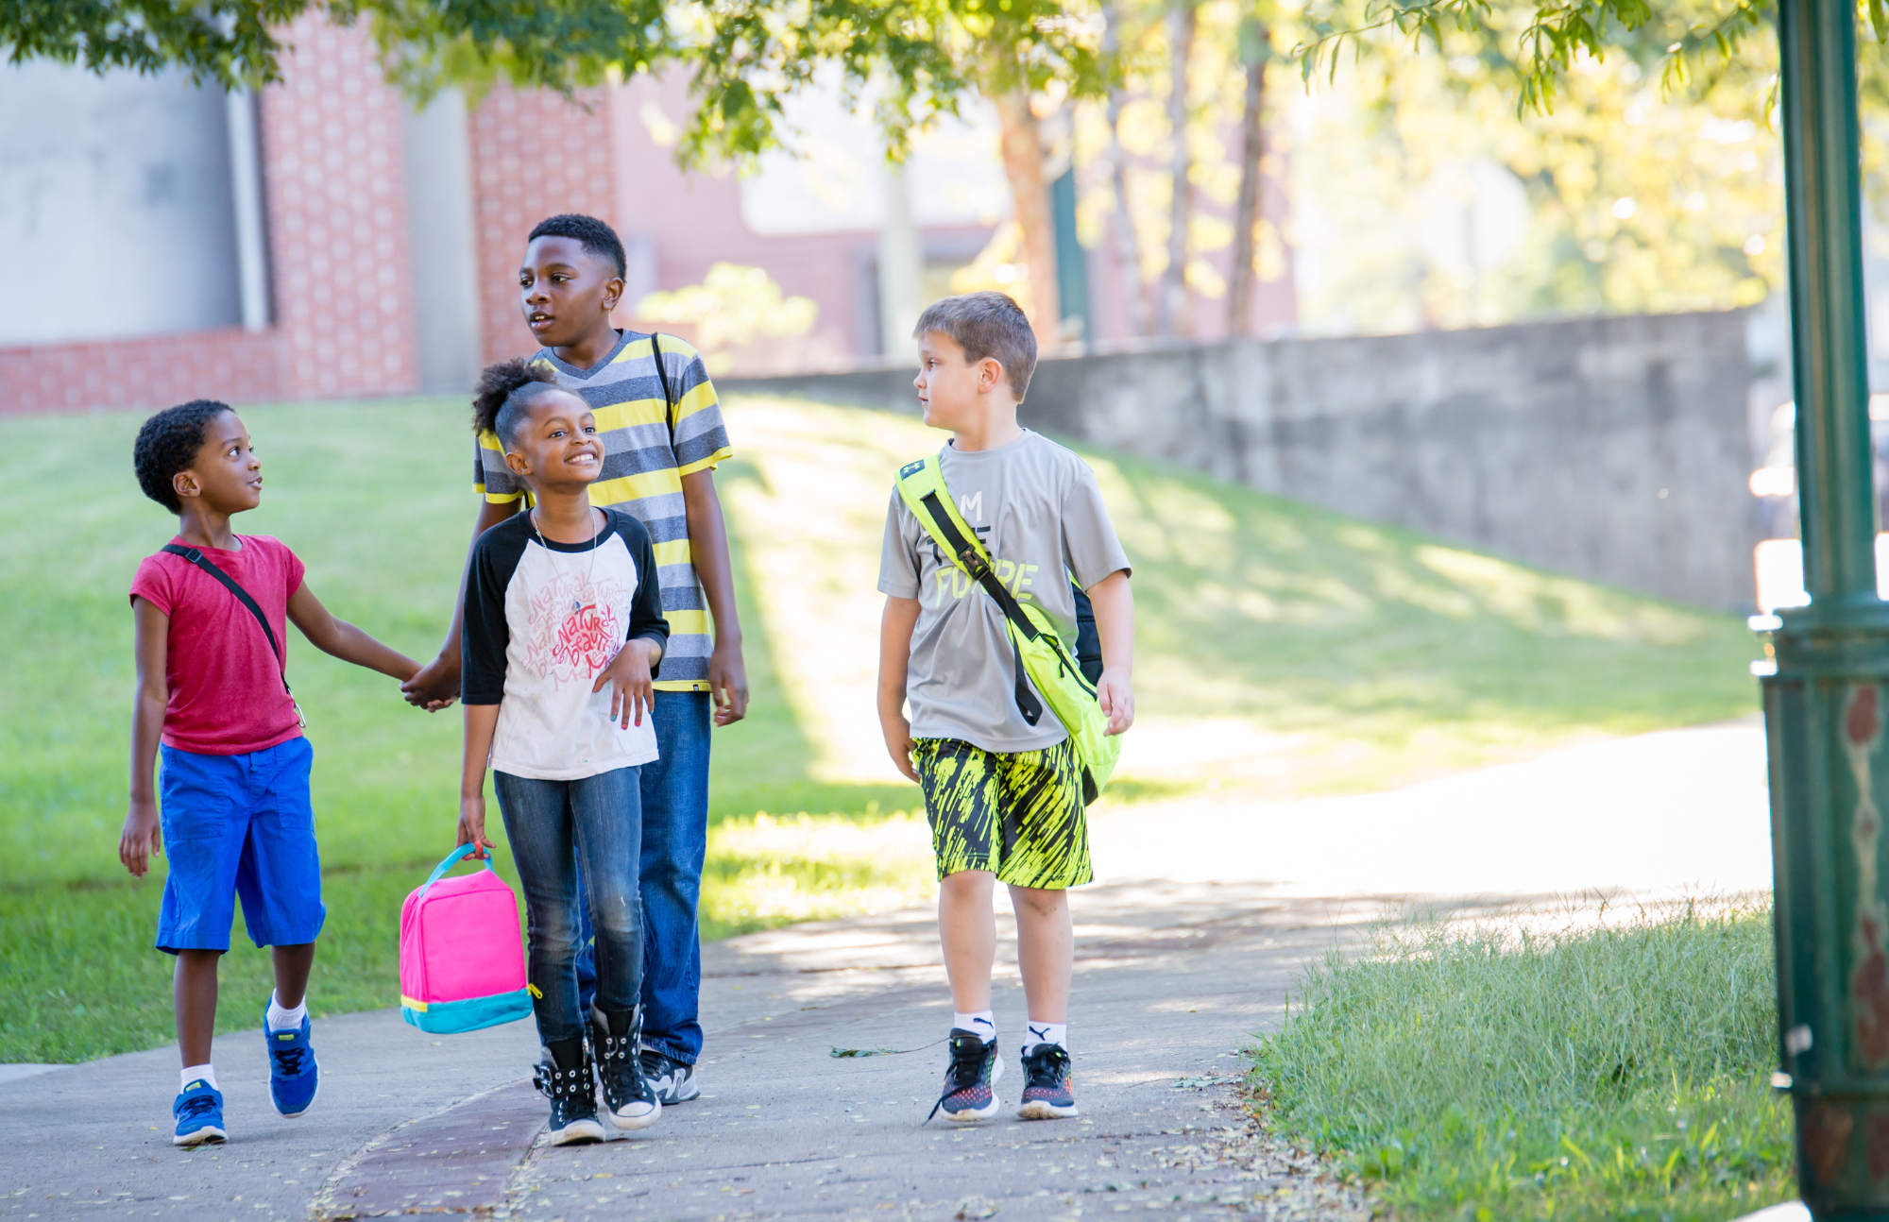
<<SCHOOL NAME>>
is celebrating
Ruby Bridges
Walk to School Day
<<SCHOOL NAME>>
is celebrating
Ruby Bridges
Walk to School Day

Slide 8
Your Logo
stamp
Celebrate Ruby Bridges Day!
On November 14, 1960, Ruby Bridges made history by becoming the first African American student to attend an all-white elementary school in the South. Her courage at just six years old helped pave the way for racial integration in schools.
Join us in honoring Ruby's bravery by participating in [Your School's Event] on [Date]. Walk to school, wear white, or discuss Ruby’s story in class.
Together, we can continue her legacy of equality and justice.
Learn More and Get Involved:
<School Website/Contact Info>
Let's walk in unity and celebrate the power of courage!
______________________________________________
_______________________
_______________________
Your Logo
stamp
Celebrate Ruby Bridges Day!
On November 14, 1960, Ruby Bridges made history by becoming the first African American student to attend an all-white elementary school in the South. Her courage at just six years old helped pave the way for racial integration in schools.
Join us in honoring Ruby's bravery by participating in [Your School's Event] on [Date]. Walk to school, wear white, or discuss Ruby’s story in class.
Together, we can continue her legacy of equality and justice.
Learn More and Get Involved:
<School Website/Contact Info>
Let's walk in unity and celebrate the power of courage!
______________________________________________
_______________________
_______________________

Slide 9


Slide 10
Your Logo
stamp
Celebrate Ruby Bridges Day!
On November 14, 1960, Ruby Bridges made history by becoming the first African American student to attend an all-white elementary school in the South. Her courage at just six years old helped pave the way for racial integration in schools.
Join us in honoring Ruby's bravery by participating in [Your School's Event] on [Date]. Walk to school, wear white, or discuss Ruby’s story in class.
Together, we can continue her legacy of equality and justice.
Learn More and Get Involved:
<School Website/Contact Info>
Let's walk in unity and celebrate the power of courage!
______________________________________________
_______________________
_______________________
Your Logo
stamp
Celebrate Ruby Bridges Day!
On November 14, 1960, Ruby Bridges made history by becoming the first African American student to attend an all-white elementary school in the South. Her courage at just six years old helped pave the way for racial integration in schools.
Join us in honoring Ruby's bravery by participating in [Your School's Event] on [Date]. Walk to school, wear white, or discuss Ruby’s story in class.
Together, we can continue her legacy of equality and justice.
Learn More and Get Involved:
<School Website/Contact Info>
Let's walk in unity and celebrate the power of courage!
______________________________________________
_______________________
_______________________

